Slide 1
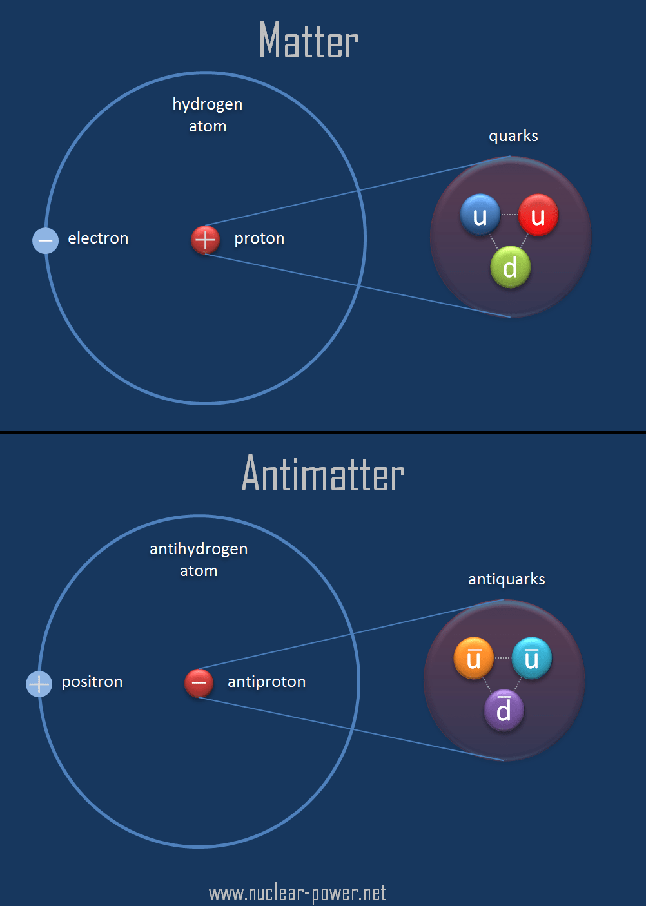
Physical science
P.S ( matter energy, movement structure of universe, no ife,just chem, phy, geography, cosmology, astronomy, geology)
Cosmology def… branch of P.S (nature of universe its structure n origin)
Universe
anti-particle (for example, proton and antiproton) have the same mass, but opposite electric charge

Slide 2
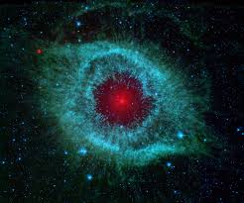
Galaxies (elliptical, spiral, sperical, irregular)
Collection of galaxy called cluster
Our galaxy is milky way
Arms of galaxy are called
Orion
Sagittarius
Sputum
Centaurs
Cygnus
Sun lies in arm
Dust and stars clouds are called NEBULA
Glow at high temp
Green is due to oxygen gas and red due to hydrogen

Slide 3
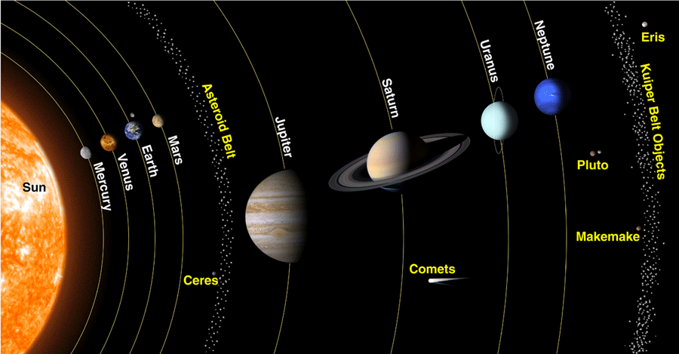
Astronomical system of units
Distance between planets and sun
Average distance between sun and earth is 150 million km equal to 1AU
Light year distance in which light travel in 1 yr
Solar system elliptical orbit
50 natural satellite
2 parts inner and outer
Asteroids belt consists of rock, stone, fe =,Ni, carbon rich materials

Slide 4
Mercury. Mercury is the smallest planet in the solar system, approximately 3000 miles (4850 km) in diameter, hardly larger than the moon. ...
Mars
Venus. ...
Earth. ...
Neptune
Jupiter. ...
Saturn. ...
Uranus. ...
Pluto.
Sun The sun is mostly composed of the elements hydrogen (H) and helium (He). By mass the composition of the sun is 75 percent hydrogen and 25 percent helium. Various metals make up less than 0.1 percent of the mass of the sun. The temperature of the sun's surface is about 10,340 degrees Fahrenheit (5,726 degrees Celsius).

Slide 5
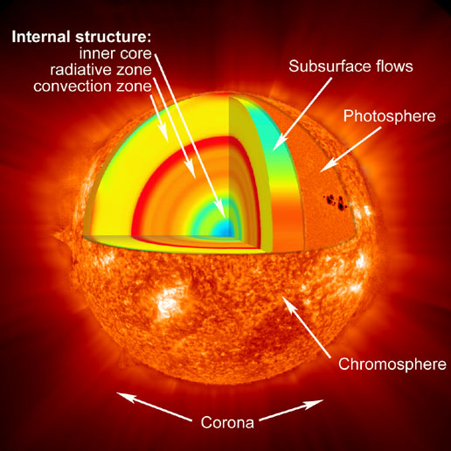
Sun layers

Slide 6
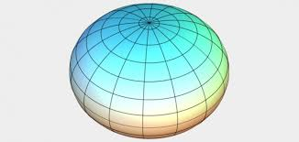
Earth
Rotation around its axis 24hrs
Revolution around the sun in 365 days
It has one moon
30% is land, 70% is ocean

Slide 7
Natural hazards:- wild fires
Def.
Uncontrolled blazes fueled by weather wind and dry under brush (crops).
Acres of land burn…
3 conditions….. Fuel(trees, grasses), oxygen,(air) heat source (cigratte, burning camping)
Favorable conditions drought, wind, warm temp,
How to control water dousing, spray phosphate comp, co2, suppresent foam
Some benefits remove diseases, disinfectants, harmful insets
Wild factors about wild fires 90% by human , spread by winds,
Effects loss off floura and funa, loss of economy, soil, erosion, air pollution,
Floods overflow of large amount of water,
Causes natural:- heavy rain, melting, cyclone, land erosion,
Man made lack OF planing, deforestation, destruction of wetlands, climate change, GW.
Kinds of floods:- over land flooding, river overflow of excessive rain, flash floods

Slide 8
People effected by floods:- farmers, local residents, transport, roads, railways,
Benefits:- return nutrients
Effects:- loss of properties, life, crops, soil erosion, disease spread, live stocks etc
Protecting against floods:- building dams, tree planting, watershed
Avalanches:- large amount of ice, rock falling, quickly down the side of mountain.
Types:- large scale ( caused by heavy rain threads to people, communication links etc)
Flash ( from arctic, antartic, winds flows towards temperate region and cause fall sharp in temp.)
Protection against avalanches:- planting trees, dig a pit, plainnng and implanting.
Types of avalanches:-
Loose, slab, powder, wet snow.
Causes:- snow stroms, heavy snow, human activities, warm temp.
Cyclones:- occur over the ocean and divided on basis of region.
Tornadoes:- form by the combination of 3 ingredients
Rising warm air
Falling cold air
Strong winds

Slide 9
Characteristics:- size 500 ft, wind speed 65 mile/hr to 250 m/hr, colour different colours, rotation southern clockwise, north anticlock wise
Categories:- tornado, gustnado, water spout, land spout, twisters.
Fact:- must stick with earth. If not then tornado
Drought:- contines period of dry weather, over months and years.
Types:- permanent, seasonal, unpredictable
Causes:- natural and human
Effects:- developing and developed countries
Tsunami:- under water, earth quake, volcanic eruption, asteroids and meteroids.
Causes:- landslidind under water, earth quake
Effects:
Warning:-
Urban fires:- uncontrolled burning fire like wild fires, in towns n cities
Damage: forestry, agri, infrastru, buildings
Causes:- Eq, electrcal wires, factories, kitchen
Volcanoes:- volcano is a mountain that has lava come from magma chamber.
Volcanos volcanos are formed by movement of tectonic plates.

Slide 10
Volcanoes consists of steam, gaseous sulphur comp, ash, broken rock pieces.
Types of volcanoes:- 4
Shield:- magma is runny, gases escape easily
Composite:- gases cannot escape, comes out with explosion
Cinder cones:- lava break in pieces.. And shoots in air
Lava domes:- when erupting lava is too thick to flow… n lava piles up near the volcanic capacity…
Causes: molten rock melt… magma rises to surface… magma formed when earth mantle melts… magma rises with explosion…
Effects of volcanoes:- positive:- volcanic ash contain minerals benefits for plants.
Negative:- rain, thunder lightning, long term effect on climate, fast moving lava kill people etc
Earth quake:- sudden movement of plates. Or sudden release of energy
causes:- tectonic movement in earth crust.
Volcanic explosion
Man made earth quake ( testing of bombs, shock waves, blasting of rock, construction of dams,roads)

Slide 11
Effects of earth quake:- ground rupture
Ground shake
Land sliding
Tsunami
Liquefication
Fires
Dark matter:- mysterious substance

Slide 12
Modern materials:- Ceramics:- Def:- consists of inorganic non metallic materials whose manufacture requires high temp., also required earthy materials like silicon with its oxides and complex compounds silicates..
Variety of ceramics:-
clay products
White wares
Glass
Porcelain enamel (glass like)
Cement
Pottery:- important category of ceramics (include clay, stone ware, porcelain)
Steps for pottery making:-
Forming-------- drying-------firing (fire convert ceramics work frm weak clay into strong durable glass like form)
Glass:- (consists of mixture of silica, soda ash, lime plus metallic oxides)
Amorphous
super cooled liquid of high viscosity

Slide 13
plastics:- def:- synthetic organic materials of high molecular wt. tht can be shaped in any form under heat…
1st celluloid synthetic ( cellulose nitrate plus camphor)
2nd bakelite ( phenol plus formaldehyde)
Characteristics:-light wt.
Electrical insulator
Chemical resistant
Transparent
Fungus resistant
Water resistant
Classification:- thermosetting plastics (melted only once
After melting become hard eg bakelite, polyester, epoxy plastics)
thermo platics (melted again and again like wax in candle eg polyethylene, nylon pvc teflon etc)
Uses:- pipe filling
Sheets
Baskets, buckets, house ware, wall tiles, pipe lining, tank, cloths

Slide 14
Semiconductor:- def:-

